Slide 1
Enterprise e-Business Systems

Slide 2
Section I
Customer Relationship Management: The Business Focus

Slide 3
Customer Relationship Management
Provides customer-facing employees with a single, complete view of every customer at every touch point and across all channels
Provides the customer with a single, complete view of the company and its extended channels

Slide 4
Customer Relationship Management (continued)
CRM..
Integrates and automates many of the customer serving processes
Creates an IT framework of Web-enabled software & databases that integrates these processes with the rest of the company’s business operations

Slide 5
Customer Relationship Management (continued)
Includes software modules that provide tools that enable a business & its employees to provide fast, convenient, dependable, consistent service.

Slide 6
Customer Relationship Management (continued)
Major Application Components
Contact & Account Management
Helps capture and track relevant data about past and planned contacts with prospects & customers.

Slide 7
Customer Relationship Management (continued)
Sales
Provides sales reps with software tools & company data needed to support & manage their sales activities.
Helps optimize cross-selling & up-selling

Slide 8
Customer Relationship Management (continued)
Marketing & Fulfillment
Helps accomplish direct marketing campaigns by automating tasks
Helps capture & manage prospect & customer response data
Helps in fulfillment by quickly scheduling sales contacts & providing appropriate information on products & services to them

Slide 9
Customer Relationship Management (continued)
Customer Service and Support
Provides software tools & real-time access to the common customer database
Helps create, assign, & manage requests for service from customers
Call center software
Help desk software

Slide 10
Customer Relationship Management (continued)
Retention and Loyalty Programs
Helps the company identify, reward, and market to their most loyal and profitable customers

Slide 11
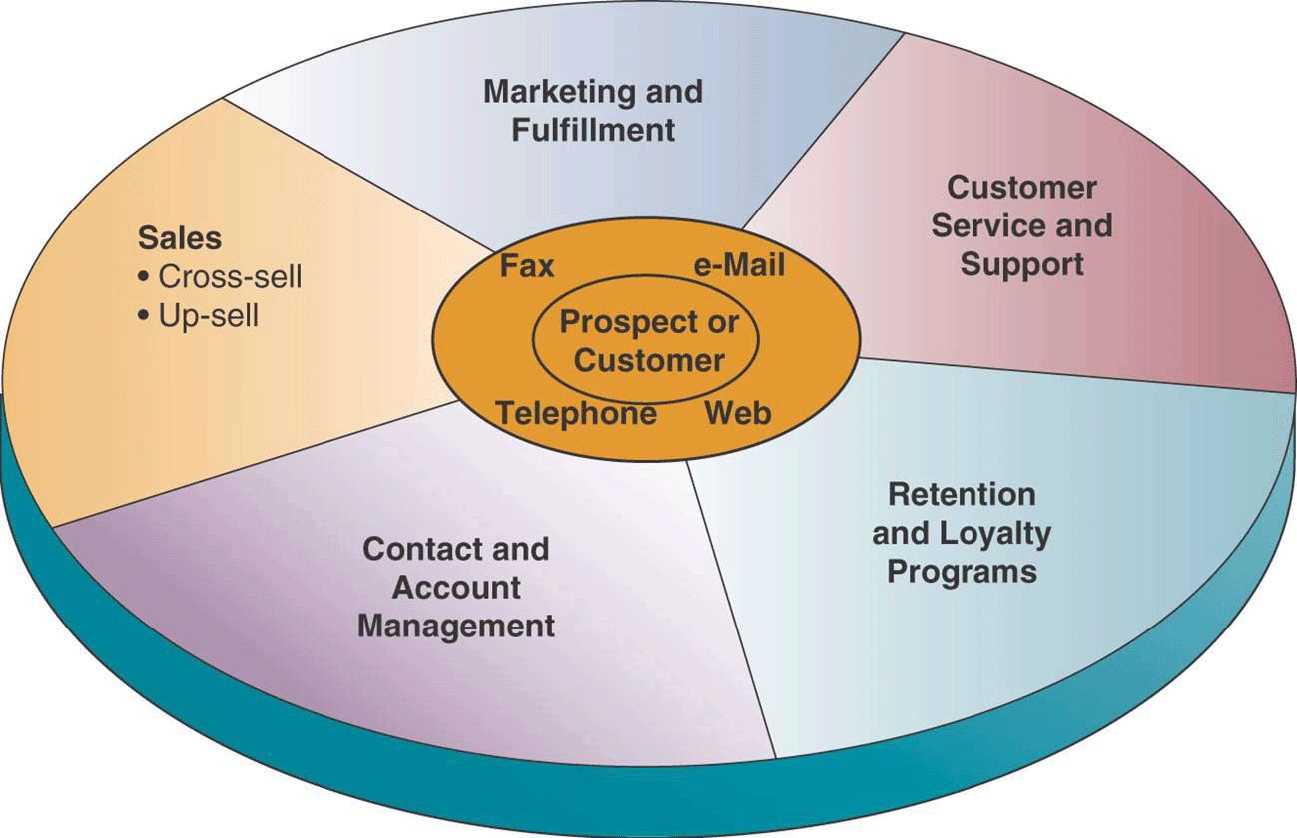
Customer Relationship Management (continued)

Slide 12
Customer Relationship Management (continued)
Three Phases of CRM
Acquire (new customers)
By doing a superior job of contact management, sales prospecting, selling, direct marketing, & fulfillment.

Slide 13
Customer Relationship Management (continued)
Enhance (customer satisfaction)
By supporting superior service from a responsive networked team of sales and service specialists.
Retain (your customers)
Help identify and reward your most loyal, profitable customers.

Slide 14
Customer Relationship Management (continued)
Benefits and Challenges
Allows a business to identify its best customers
Makes possible real-time customization & personalization of products & services based on customer wants, needs, buying habits, & life cycles

Slide 15
Customer Relationship Management (continued)
Benefits and Challenges (continued)
Enables a company to provide a consistent customer service experience
Failures
Due to lack of understanding & preparation.
CRM is not a silver bullet

Slide 16
Section II
Enterprise Resource Planning: The Business Backbone

Slide 17
Enterprise Resource Planning
Serves as a cross-functional enterprise backbone that integrates & automates many internal business processes and information systems
Helps companies gain the efficiency, agility, & responsiveness needed to succeed today

Slide 18
Enterprise Resource Planning (continued)
Gives a company an integrated real-time view of its core business processes
ERP software suites typically consist of integrated modules of…
Manufacturing
Distribution
Sales
Accounting
Human Resource Management

Slide 19
Enterprise Resource Planning (continued)
Benefits and Challenges
Quality and efficiency
Helps improve the quality and efficiency of customer service, production, & distribution by creating a framework for integrating and improving internal business processes
Decreased Costs
Reductions in transaction processing costs and hardware, software, and IT support staff

Slide 20
Enterprise Resource Planning (continued)
Decision support
Provides cross-functional information on business performance to assist managers in making better decisions
Enterprise agility
Results in more flexible organizational structures, managerial responsibilities, and work roles

Slide 21
Enterprise Resource Planning (continued)
Costs of ERP
The costs and risks of failure in implementing a new ERP system are substantial.

Slide 22
Enterprise Resource Planning (continued)
Causes of ERP failures
Underestimating the complexity of the planning, development, and training required
Failure to involve affected employees in the planning & development phases and change management programs

Slide 23
Enterprise Resource Planning (continued)
Trying to do too much, too fast
Insufficient training
Believing everything the software vendors and/or consultants say

Slide 24
Section III
Supply Chain Management: The Business Network

Slide 25
Supply Chain Management
A cross-functional interenterprise system that uses IT to help support & manage the links between some of a company’s key business processes and those of its suppliers, customers, & business partners.
Goal is to create a fast, efficient, & low-cost network of business relationships.

Slide 26
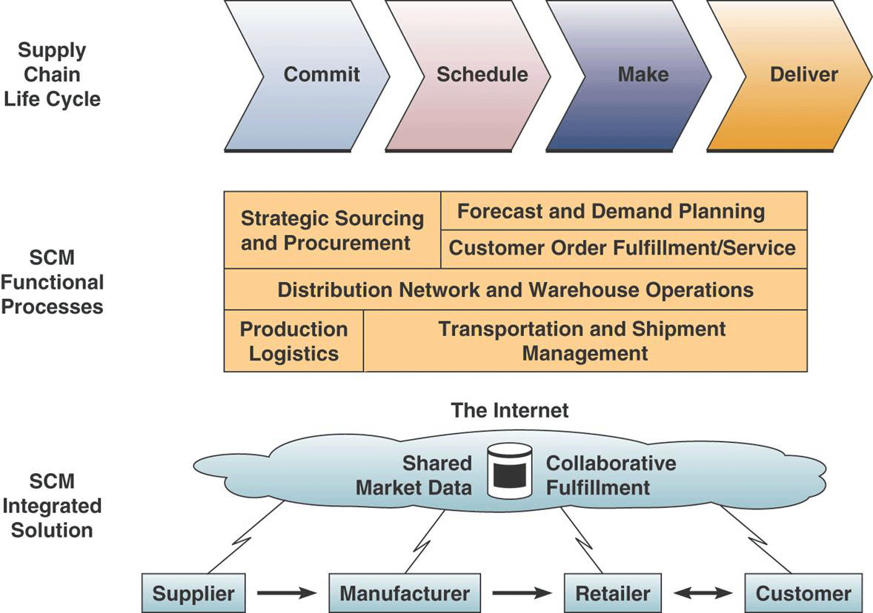
Supply Chain Management (continued)

Slide 27
Supply Chain Management (continued)
Electronic data interchange
Exchanging business transaction documents over the Internet & other networks between supply chain trading partners

Slide 28
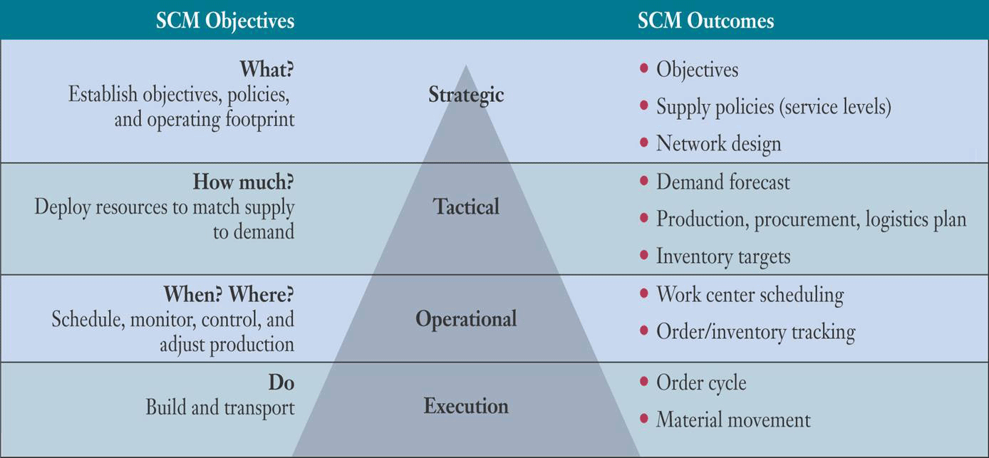
Supply Chain Management (continued)
The Role of SCM

Slide 29
Supply Chain Management (continued)
Benefits and Challenges
Can provide faster, more accurate order processing, reductions in inventory levels, quicker time to market, lower transaction and materials costs, & strategic relationships with suppliers

Slide 30
Supply Chain Management (continued)
Problem causes
Lack of proper demand planning knowledge, tools, and guidelines
Inaccurate or overoptimistic demand forecasts
Inaccurate production, inventory, and other business data
Lack of adequate collaboration

Slide 31
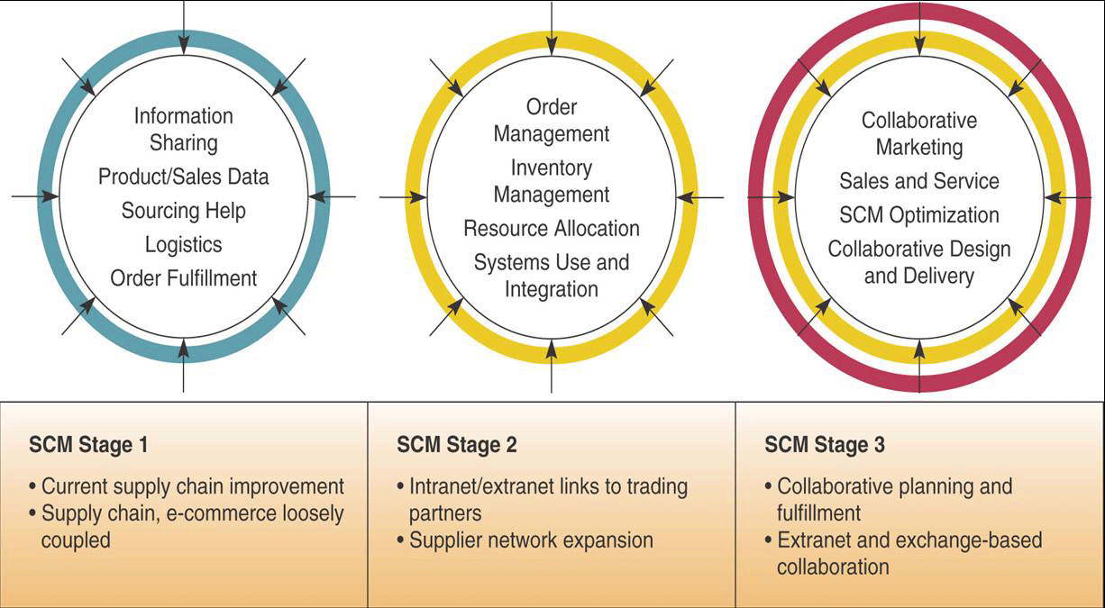
Supply Chain Management (continued)
Trends

